Slide 1

Web Assembly

Slide 2



Web Assembly
What?

Slide 3



Web Assembly
Why?
Gaming
Video Editing
Simulations

Slide 4
Web Assembly
Compilation of High-Level Languages into web assembly using Compilers like emscripten or Rust’s toolchains.
Modern Browser has a separate execution engine in designed to be fast, secure and sandboxed(i.e. Runs in Isolation)
JavaScript loads the Web Assembly modules into the browser.
WASM Itself does not replaces JavaScript, Rather it works along side JavaScript.
How?

Slide 5
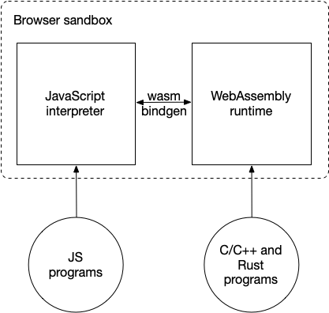
Web Assembly
Diagram

Slide 6
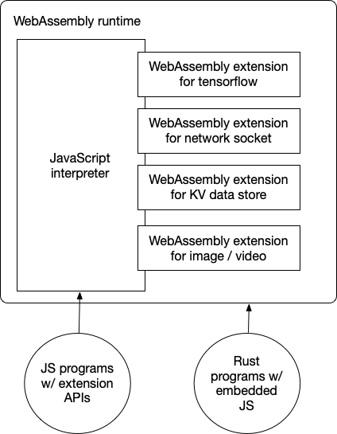
Web Assembly
Diagram

Slide 7
Web Assembly
Working
Clicks
Calls Pre-Compiled
WASM
HTML/CSS
JS
WASM
Update UI/Response
Response From WASM

Slide 8
Web Assembly
Flow
(module
;; Import a function for printing from JavaScript
(import "env" "print" (func $print (param i32)))
;; Memory for stringsi
(memory 1)
(export "memory" (memory 0))
;; Data for the "Hello, WebAssembly!" string
(data (i32.const 0) "Hello, WebAssembly!\00")
;; Main function, which calls print
(func $main
;; Pass the memory location of the string to the print function
i32.const 0
call $print
)
;; Export the main function
(export "main" (func $main))
)
public class HelloWorld {
public static void main(String[] args) {
System.out.println("Hello, WebAssembly!");
}
}
JavaScript
Loads WASM
JVM
TeaVM
.class/ jar file
0061736d 01000000 01076173 6d2e6461 74612e72 00000000 0a1e04f0 00000000 00050001 011e2000 01000000 07000001 ...
Binary format
Human Read-able Presentation

Slide 9
Web Assembly
Benefits
Execution Speed: Since WebAssembly is compiled into bytecode, it’s faster to execute than JavaScript for many tasks, especially those that require heavy computation (e.g., image processing, 3D rendering).
Security Benefits: WebAssembly runs in a safe, sandboxed environment, similar to how JavaScript runs in the browser, preventing access to the operating system or file system.
Memory Safety: WebAssembly has strict memory management rules to prevent buffer overflows and other common vulnerabilities.

Slide 10
Web Assembly
Real-World Examples
Figma: A web-based design tool that uses Web Assembly for better performance.
Autodesk: Uses Web Assembly to bring CAD software into the browser.
Games: Web Assembly is used to port games like DOOM 3 to run in browsers with native-like performance.

Slide 11
Web Assembly
Future
WebAssembly System Interface (WASI): WebAssembly is evolving to not just work in browsers but also run in other environments, like servers. WASI (WebAssembly System Interface) allows WebAssembly to interact with operating systems and hardware, extending its use beyond just browsers.
Adoption in Other Platforms: Discuss the adoption of WebAssembly outside of web browsers, such as in cloud computing (e.g., Fastly’s Compute@Edge), IoT devices, or game engines.

